Slide 1
Advance Algorithm Design Techniques
Ram Krishna Dahal
Asst. Professor
Central Department of computer science and IT, TU

Slide 2
Optimization problem solving technique
Problem with multiple feasible solution
We need to find the maximum/minimum (optimum) out of them
Techniques to solve such optimization problem are
Greedy method
Dynamic programming
Backtracking
Branch and bound

Slide 3
Greedy Method
Simplest and straightforward approach
Decision is taken on the basis of current available information without worrying about the effect of the current decision in future.
It built a solution part by part, choosing the next part in such a way, that it gives an immediate benefit.
This approach never reconsiders the choices taken previously.
Easy to implement and quite efficient in most of the cases.
Based on heuristic that follows local optimal choice at each step with the hope of finding global optimal solution.
In many problems, it does not produce an optimal solution though it gives an approximate (near optimal)

Slide 4
Components of Greedy Algorithm
Greedy algorithms have the following five components −
A candidate set − A solution is created from this set.
A selection function − Used to choose the best candidate to be added to the solution.
A feasibility function − Used to determine whether a candidate can be used to contribute to the solution.
An objective function − Used to assign a value to a solution or a partial solution.
A solution function − Used to indicate whether a complete solution has been reached.

Slide 5
Areas of Application
Greedy approach is used to solve many problems, such as
Finding the shortest path between two vertices using Dijkstra’s algorithm.
Finding the minimal spanning tree in a graph using Prim’s /Kruskal’s algorithm, etc.
Where Greedy Approach Fails
In many problems, Greedy algorithm fails to find an optimal solution, moreover it may produce a worst solution. Problems like Travelling Salesman and Knapsack cannot be solved using this approach.

Slide 6
Job Sequencing with Deadline
Problem Statement
In job sequencing problem, the objective is to find a sequence of jobs, which is completed within their deadlines and gives maximum profit.

Slide 7
Job Sequencing with Deadline
Solution
Let us consider, a set of n given jobs which are associated with deadlines and profit is earned, if a job is completed by its deadline. These jobs need to be ordered in such a way that there is maximum profit.
It may happen that all of the given jobs may not be completed within their deadlines.
Assume, deadline of i^{th} job J_{i} is d_{i} and the profit received from this job is p_{i}. Hence, the optimal solution of this algorithm is a feasible solution with maximum profit.
Thus, D(i)>0 for 1⩽i⩽n
Initially, these jobs are ordered according to profit, i.e. p1⩾p2⩾p3⩾...⩾pn

Slide 8
Job Sequencing with Deadline
Greedy_Job (D, P, J, n) {
//Sort the jobs in non-increasing order of p_{i}
J= {1}; //job of index 1
for i= 2 to n do {
if all deadlines in J U {i} are feasible then
J= J U {i};}
Return J;
}

Slide 9
Job Sequencing with Deadline
Algorithm: Job-Sequencing-With-Deadline (D, J, n, k) D(0) = J(0) = 0;
k = 1; J(1) = 1; // means first job is selected
for i = 2 … n do
r = k
while D(J(r)) > D(i) and D(J(r)) ≠ r do r--;
if D(J(r)) ≤ D(i) and D(i) > r then {
for q = k … r + 1 by -1 do {
J(q + 1) = J(q)
J(r + 1) = i
k = k + 1
Return (K);

Slide 10
Job Sequencing with Deadline
Analysis
In this algorithm, we are using two loops, one is within another. Hence, the complexity of this algorithm is O(n²)

Slide 11
Job Sequencing with Deadline
Example
Let us consider a set of given jobs as shown in the following table. We have to find a sequence of jobs, which will be completed within their deadlines and will give maximum profit. Each job is associated with a deadline and profit.
Job | J₁ | J₂ | J₃ | J₄ | J₅
Deadline | 2 | 1 | 3 | 2 | 1
Profit | 60 | 100 | 20 | 40 | 20

Slide 12
Job Sequencing with Deadline
Solution
To solve this problem, the given jobs are sorted according to their profit in a descending order. Hence, after sorting, the jobs are ordered as shown in the following table.
Job | J₂ | J₁ | J₄ | J₃ | J₅
Deadline | 1 | 2 | 2 | 3 | 1
Profit | 100 | 60 | 40 | 20 | 20

Slide 13
Job Sequencing with Deadline
From this set of jobs, first we select J₂, as it can be completed within its deadline and contributes maximum profit.
Next, J₁ is selected as it gives more profit compared to J₄.
In the next clock, J₄ cannot be selected as its deadline is over, hence J₃ is selected as it executes within its deadline.
The job J₅ is discarded as it cannot be executed within its deadline.
Thus, the solution is the sequence of jobs (J₂, J₁, J₃), which are being executed within their deadline and gives maximum profit.
Total profit of this sequence is 100 + 60 + 20 = 180.

Slide 14
Try your own
Jobs | J1 | J2 | J3 | J4
Deadline | 2 | 1 | 2 | 1
Profit | 100 | 10 | 15 | 27
Jobs | J1 | J2 | J3 | J4
Deadline | 2 | 2 | 2 | 2
Profit | 30 | 15 | 75 | 80

Slide 15
Tree Vertex Splitting
Given a directed binary tree labeled with weight
Weighted tree can be used in distribution network in which electric signals or oil can be transmitted
Loss occurs in the process of transmission
Each edge in the tree is labeled with the loss that occurs in traversing the edge
Network may not be able to tolerate losses beyond a certain
A booster have to be placed where the loss exceeds the tolerance level δ
The booster can only be placed in the nodes of the tree

Slide 16
Tree Vertex Splitting
Problem
Given a network and a loss tolerance level, the tree vertex splitting problem is to determine the optimal placement of boosters.
i.e. Tree vertex splitting problem is to identify a set X ⊆ V of minimum cardinality (minimum number of booster stations) for which d(T /X) ≤ δ for some specified tolerance limit δ
TVSP has a solution only if the maximum edge weight is ≤ δ

Slide 17

Tree Vertex Splitting
Solution
We want to minimize the number of booster stations (X)
For each node u ∈ V , compute the maximum delay d(u) from u to any other node in its subtree
If u has a parent v such that d(u) + w(v, u) > δ, split u and set d(u) to zero
Computation proceeds from leaves to root
Delay for each leaf node is zero
The delay for each node v is computed from the delay for the set of its children C(v)
If d(v) > δ, split v

Slide 18
Tree Vertex Splitting
Algorithm TVS(T,delta){
//Determine and output the nodes to be split. //w() is the weighting function for the edges. if(T!=0) then { d[T]=0; for each child v of T do { TVS(v,delta); d[T]=max{d[T],d[v] + w(T,v)};} if((T is not the root) && (d[T] +w(parent(T),T)>l)){ write(T); d[T]=0;}
}}

Slide 19
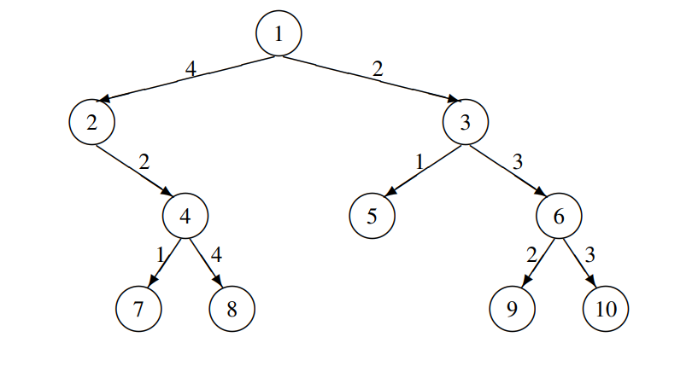
Tree Vertex Splitting
Example
Solve the above tree with δ = 5

